Slide 1

Notes:
"Good (morning/afternoon) everyone. My name is Saim Mahmud, and this presentation is for my course, CIS 512, Introduction to Data Science.
Today, I’m excited to present 'The Tech Talent Report.' This is a data-driven analysis of what's happening in the job market right now, focusing on the most in-demand sectors, the skills employers are looking for, and the compensation trends that follow."

Slide 2
Today's Agenda
Market Overview: Top Sectors & Job Volume
In-Demand Skills: Top 10 Skills by Sector
The Job Map: Geographic Distribution Across the US
City Hotspots: Salary vs. Opportunity in Key Locations
Key Employers: Who is Hiring and What They Pay
Career Growth: Compensation by Experience Level
Final Insight: Company Revenue vs. Employee Rating
Notes:
We'll start with a high-level market overview of the top sectors. From there, we'll drill down into the specific skills that are most in-demand.
Then, we'll pivot to geography, looking at the 'job map' of the US and zooming in on the top city hotspots. We'll follow that by looking at who is hiring and how compensation changes with experience.
Finally, we'll close with a very interesting insight I found, comparing company revenue to employee satisfaction.

Slide 3
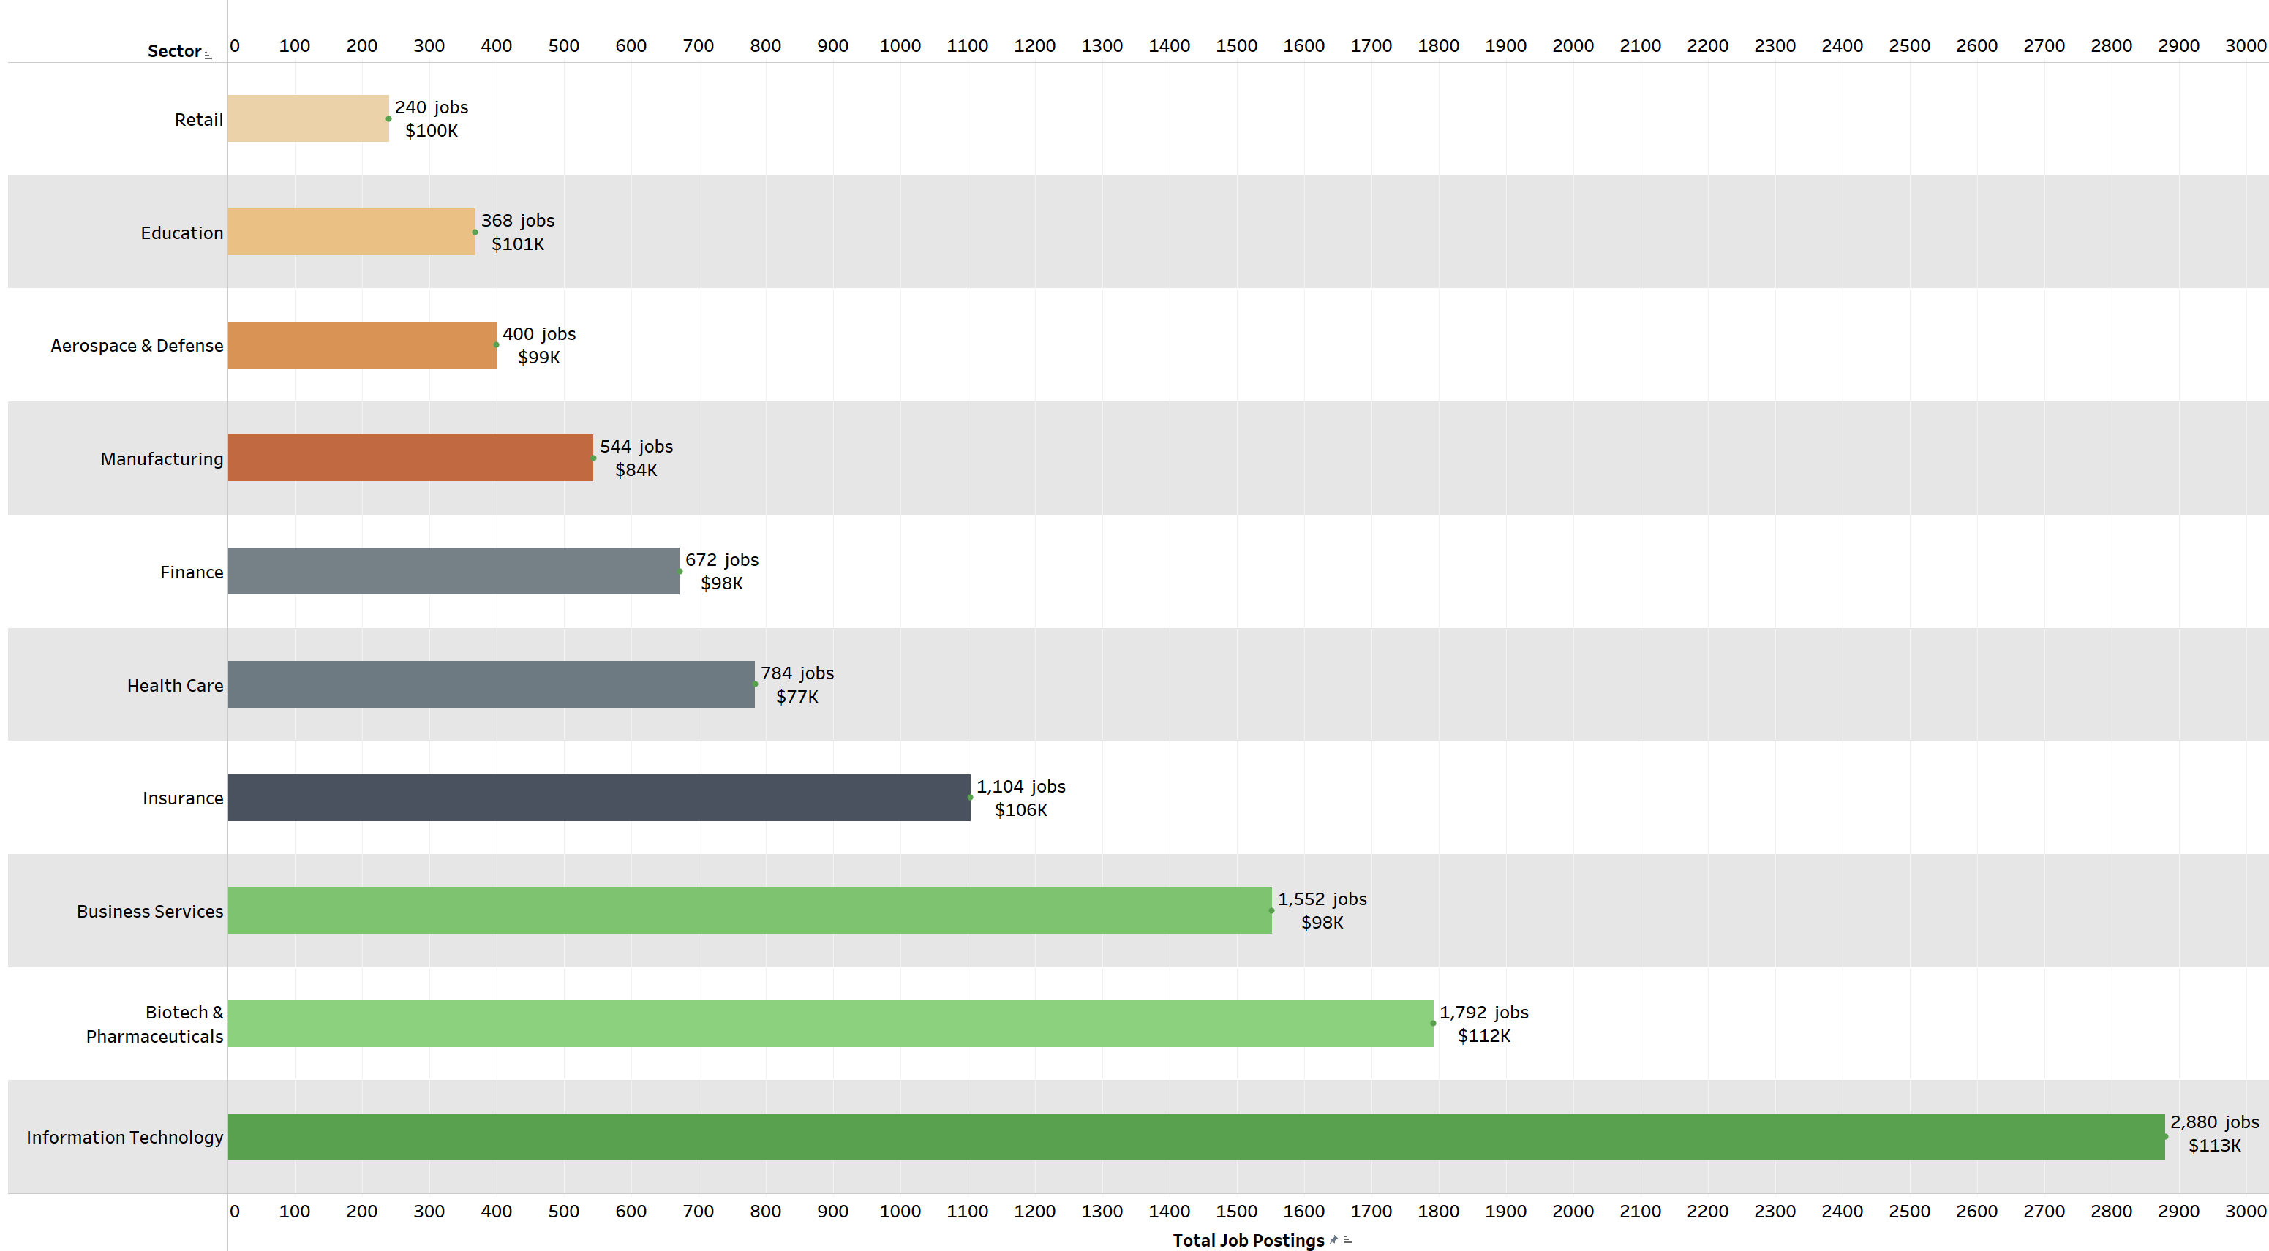
Top 10 Sectors — Job Volume & Compensation
Notes:
First, let's look at the big picture. This chart shows the top 10 sectors by job volume.
As you can see, Information Technology is, by far, the dominant sector with nearly 2,900 jobs. But what's also clear is the strength of Biotech & Pharma and Business Services, which are the next two biggest employers.
We can also see compensation here. The top-paying sectors, like IT, Biotech, and Insurance, all show average salaries well over $100,000, while Health Care, which has a high volume of jobs, has a lower average salary at $77K.

Slide 4
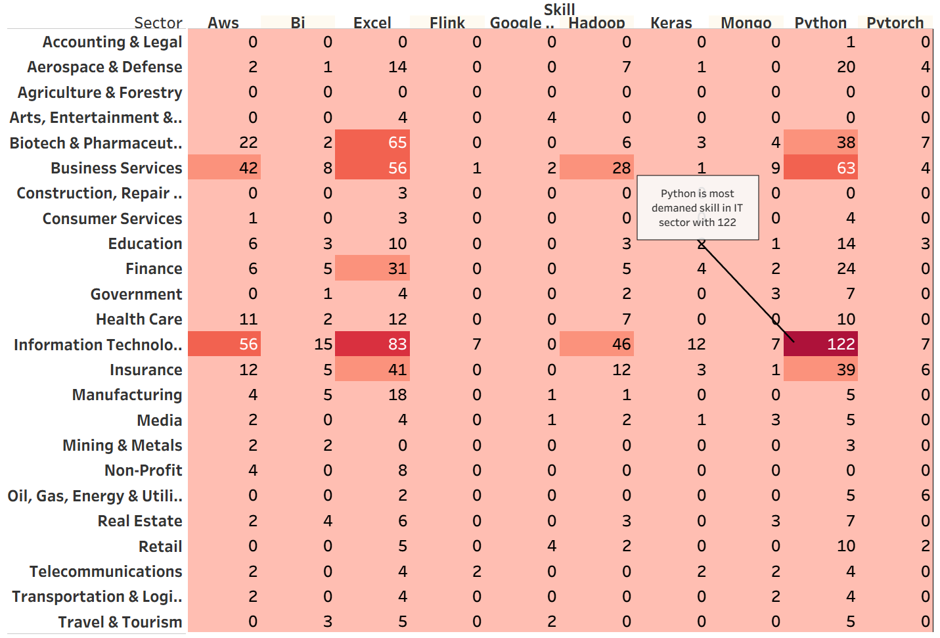
Most Demanded Top 10 Skill in Job Sector
Notes:
So, we know which sectors are hiring, but what skills do they want? This heatmap answers that question.
in the Information Technology sector, Python is the most demanded skill, appearing in 122 job postings.
But it's not just about Python. Look at the high numbers for Excel and AWS. These are critical skills that cut across multiple sectors, especially in Business Services, Insurance, and Finance. This shows that foundational business skills and cloud skills are in high demand just about everywhere.“
"This chart shows the top 10 skills in the IT sector.
Python is number one, with 122 jobs. SQL is second, with 109 jobs. After that are Excel with 83, Spark with 72, and AWS with 56."

Slide 5
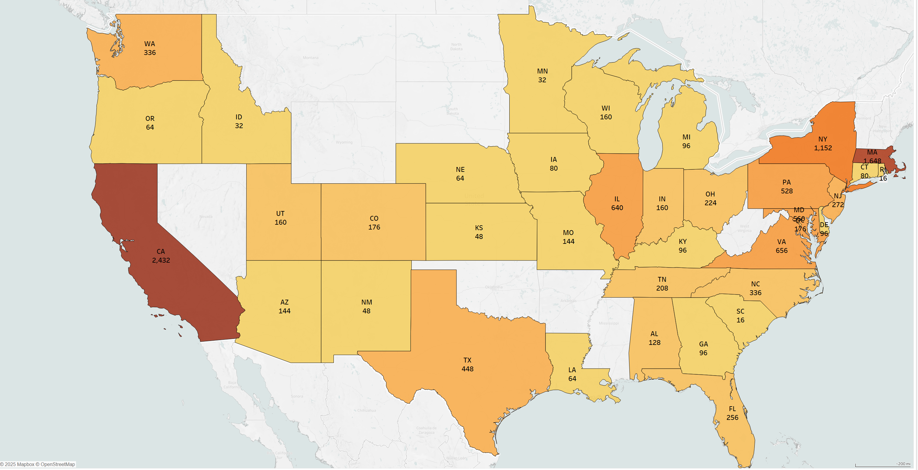
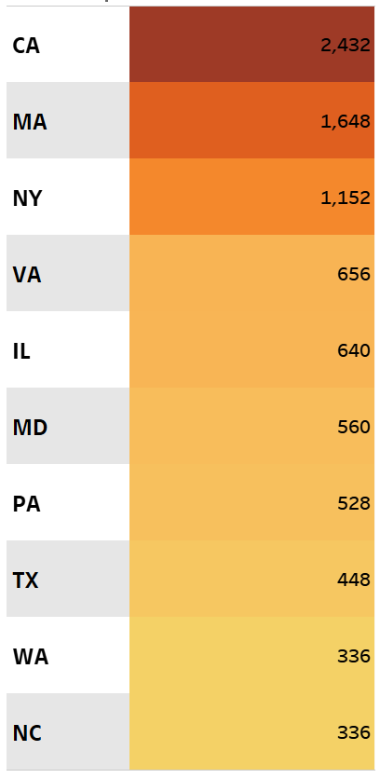
Geographic Distribution of Jobs
Top 10 States
Notes:
This map shows the geographic distribution of jobs, and the key takeaway is immediately clear: the job market is not evenly spread out. It is heavily concentrated on the coasts.
You can see California is the absolute leader with over 2,400 jobs. But the East Coast is also a massive powerhouse, with Massachusetts having over 1,300 jobs and New York with over 1,100.

Slide 6
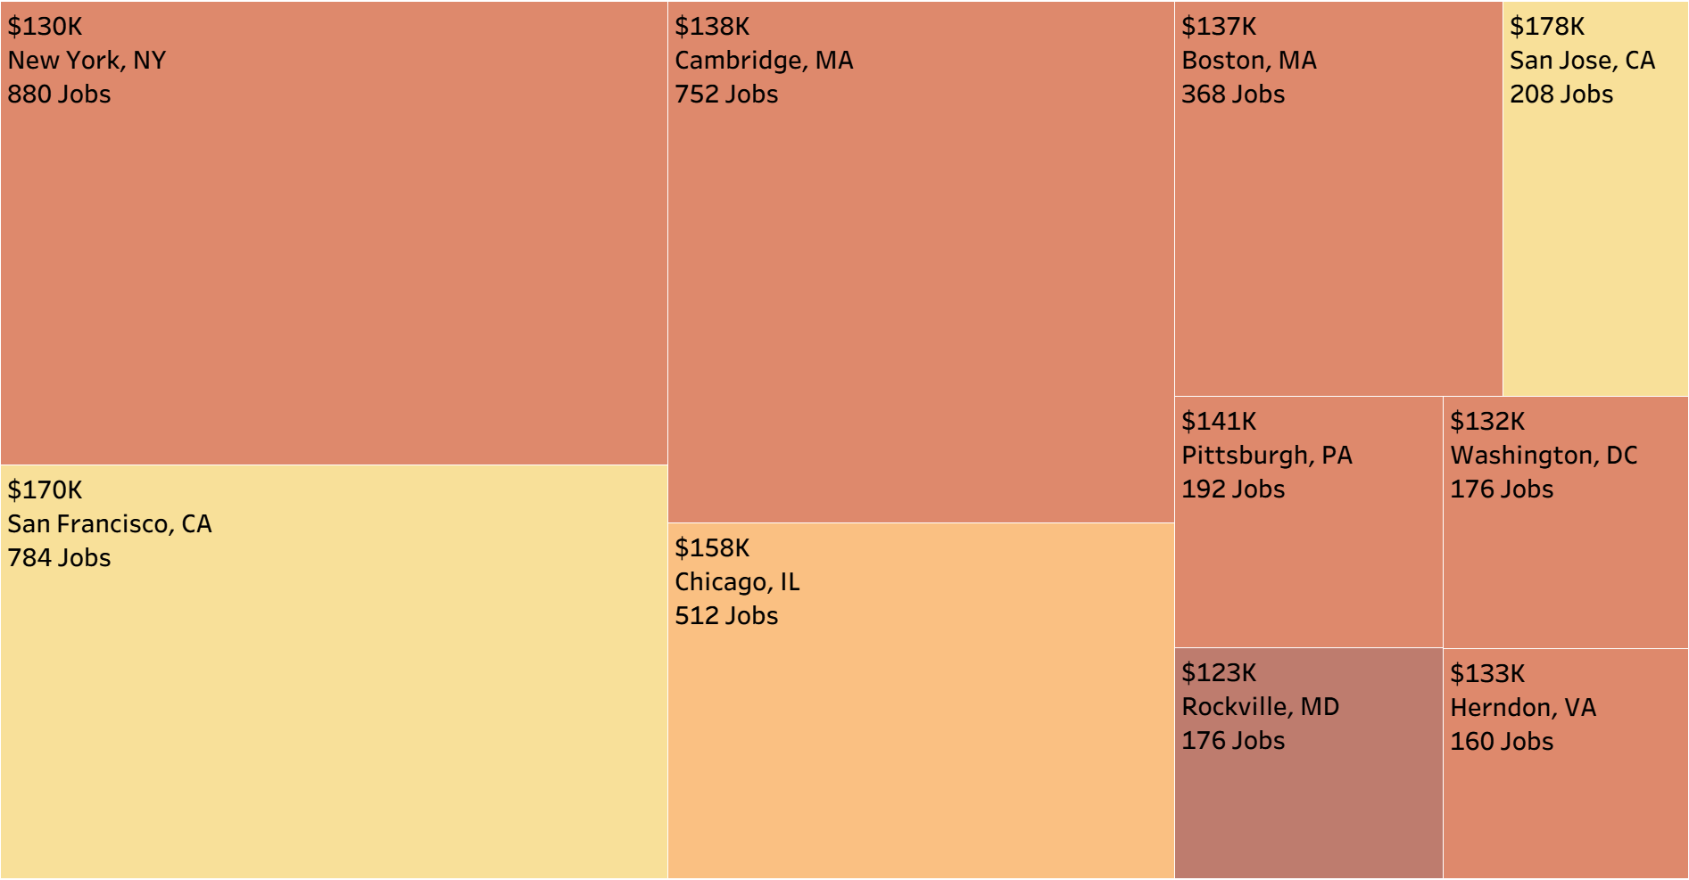
Average Upper Salary by Top 10 Job Locations (City)
Notes:
"Zooming in from the state level, this treemap shows the top 10 cities. And this is where we see a clear trade-off between opportunity and compensation.
On one hand, New York City has the highest volume of jobs, at 880.
But if you look at salary, the Bay Area leads. San Jose offers the highest average salary at $178,000, with San Francisco close behind at $170,000. This data shows a clear choice for job seekers: are you looking for the most opportunities, or the highest possible pay?"

Slide 7
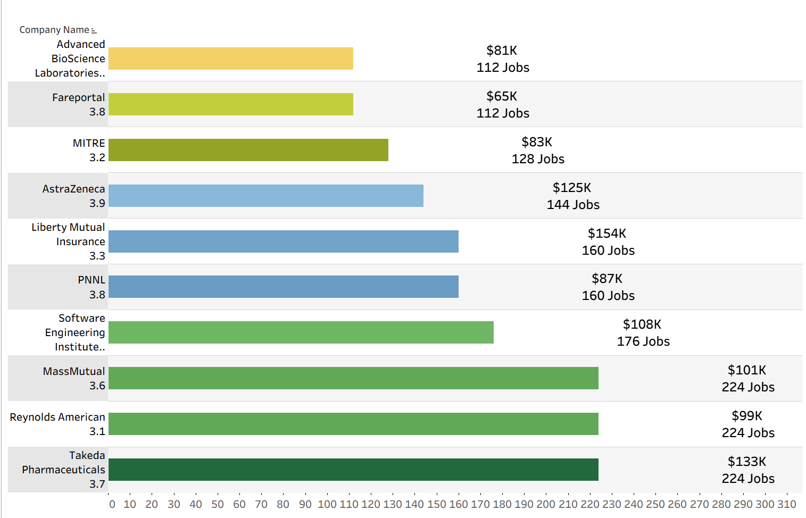
Top Employers by Job Volume, with Average Salary
Notes:
"So, who is hiring? This chart shows the top employers. You can see a three-way tie for the most jobs: Takeda, Reynolds, and MassMutual all have 224 openings.
But look at the pay. The salaries are all over the place. Liberty Mutual has the highest average salary on the list, at $154K. Meanwhile, Fareportal, which has 112 jobs, is at the low end with $65K. This shows a very wide range of pay, even among top employers."

Slide 8
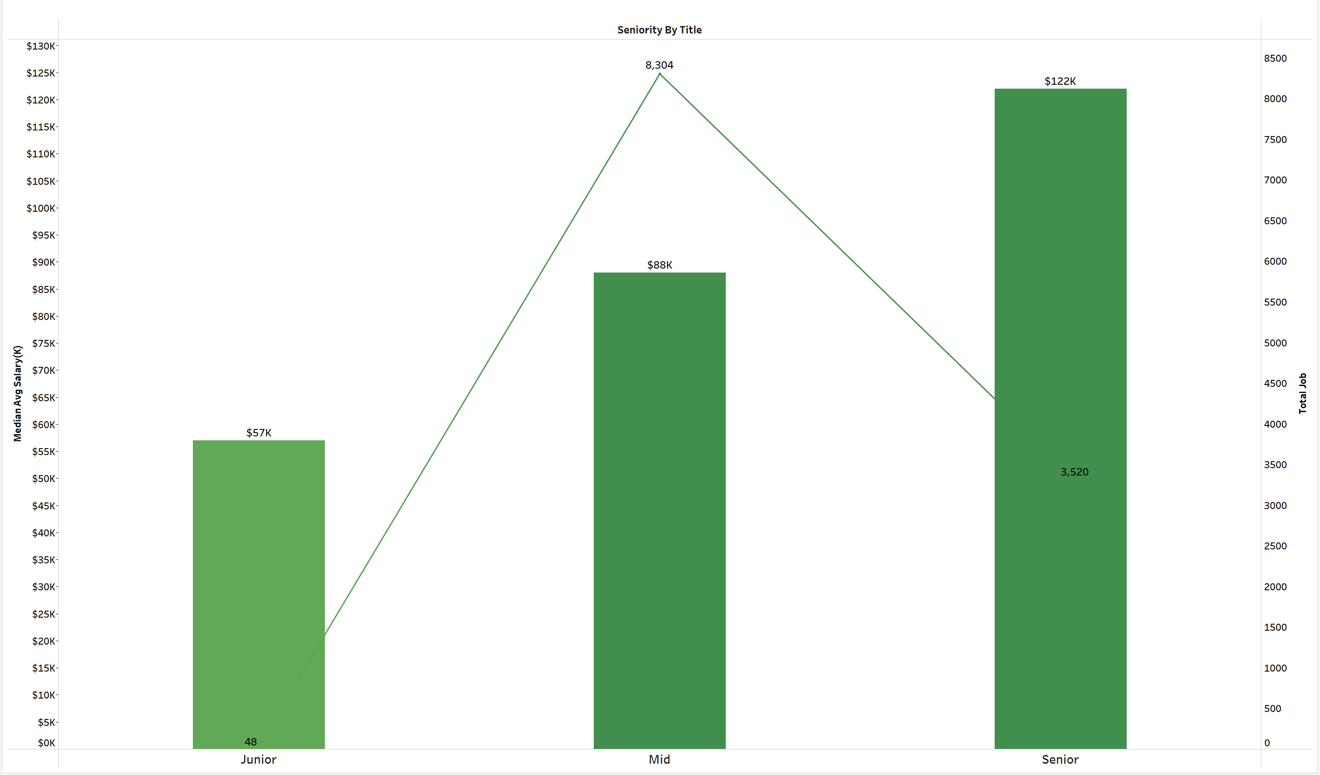
Compensation by Experience Level
Notes:
Now, let's look at compensation by experience. This chart tells a really important story about the structure of the job market.
we see exactly what we'd expect with salary: pay goes up significantly with experience. It starts at $57K for Junior roles, jumps to $88K for Mid-Level, and reaches $122K for Senior positions.
Look at the Junior level. There are only 48 jobs. This suggests a very high barrier to entry. It's very competitive to get that first 'foot in the door.'
But then, look at what happens at the Mid-Level. The number of jobs explodes to over 8,300. This is the core of the entire market.

Slide 9
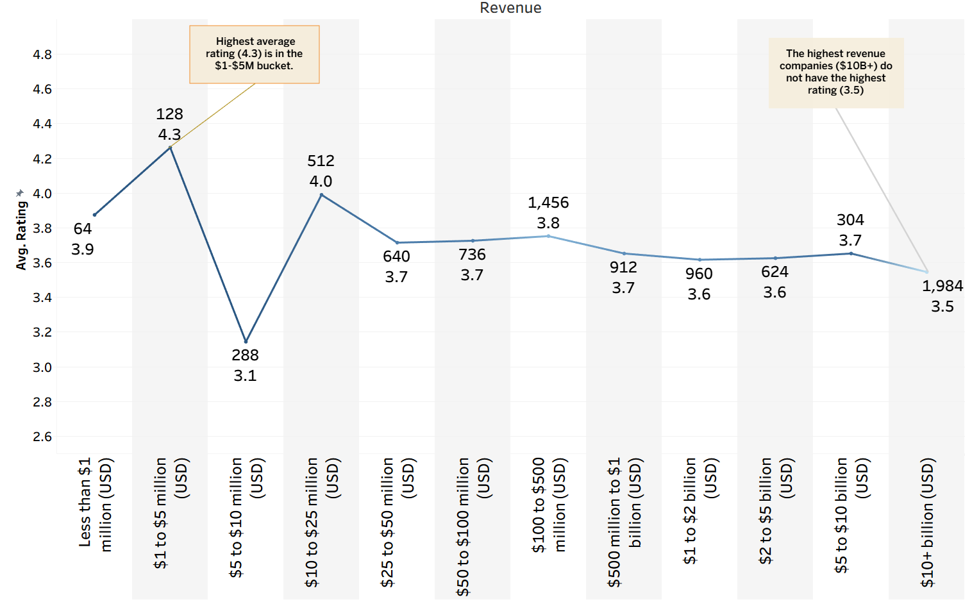
Average Rating by Company Revenue Bracket
Notes:
"Last slide. This one is interesting. Are workers at big companies happier? The data says no. The highest rating, 4.3, is from small companies in the $1-5 million group. There were 128 companies in that bucket. Now look at the biggest companies, the $10B+ group. That's the largest group, with almost 2,000 companies, but they have one of the lowest ratings at 3.5. So, bigger isn't better. The happiest workers are at smaller companies."

Slide 10


